Slide 1
Converting among Representations
Can convert from any representation to any other
Common conversions
  Equation to circuit (we did this earlier)
  Truth table to equation (which we can convert to circuit)
    Easy -- just OR each input term that should output 1
  Equation to truth table
    Easy -- just evaluate equation for each input combination (row)
    Creating intermediate columns helps
Inputs
Outputs
Term
a
b
F
F = sum of
0
0
1
a’b’
0
1
1
a’b
1
0
0
1
1
0
F = a’b’ + a’b
Q: Convert to equation
a
b
c
F
0
0
0
0
0
0
1
0
0
1
0
0
0
1
1
0
Q: Convert to truth table: F = a’b’ + a’b
1
0
0
0
1
0
1
1
ab’c
Inputs
Output
1
abc’
a
b
a
'
b
'
a
' b
F
1
1
0
1
1
1
1
abc
a
0
0
1
0
1
a
0
1
0
1
1
F = ab’c + abc’ + abc
1
0
0
0
0
1
1
0
0
0

Slide 2
Decoder Example
New Year’s Eve Countdown Display
  Microprocessor counts from 59 down to 0 in binary on 6-bit output
  Want illuminate one of 60 lights for each binary number
  Use 6x64 decoder
    4 outputs unused
2
1
0
2
1
0
0
Happy
0
1
0
i0
d0
0
0
1
New Year
1
0
0
i1
d1
0
1
0
1
0
0
0
i2
d2
1
0
0
2
essor
0
0
0
i3
d3
0
0
0
3
c
0
0
0
i4
a
o
r
0
0
0
op
i5
r
0
0
0
ic
d58
M
e
d59
0
0
0
d60
d61
58
6x64
d62
59
dcd
d63

Slide 3
Controller Design: Laser Timer Example
Step 1: Capture the FSM
  Already done
Step 2: Create architecture
  2-bit state register (for 4 states)
  Input b, output x
  Next state signals n1, n0
Step 3: Encode the states
  Any encoding with each state unique will work
Inputs: b; Outputs: x
x=0
00
b
’
O
ff
a
b
x=1
x=1
x=1
01
On1
10
On2
11
On3
FSM
inputs
outputs
b
x
FSM
FSM
outputs
Combinational
logic
n1
n0
s1
s0
a
clk
State register

Slide 4
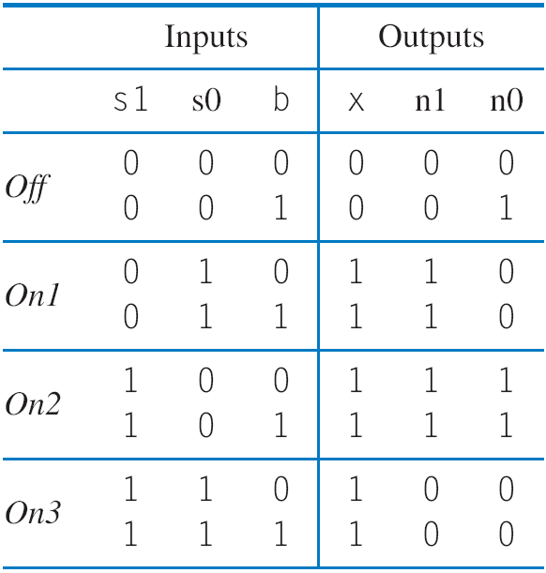
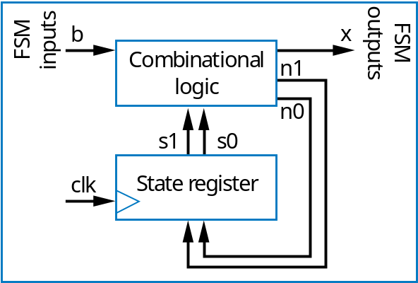
Controller Design: Laser Timer Example (cont)
Step 4: Create state table
Inputs: b; Outputs: x
x=0
00
b
’
O
ff
b
a
x=1
x=1
x=1
01
On1
10
On2
11
On3

Slide 5
Controller Design: Laser Timer Example (cont)
Step 5: Implement combinational logic
a
x = s1 + s0 (note from the table that x=1 if s1 = 1 or s0 = 1)
n1 = s1’s0b’ + s1’s0b + s1s0’b’ + s1s0’b
n1 = s1’s0 + s1s0’
n0 = s1’s0’b + s1s0’b’ + s1s0’b
n0 = s1’s0’b + s1s0’

Slide 6
Controller Design: Laser Timer Example (cont)
Step 5: Implement combinational logic (cont)
Combinational Logic
FSM outputs
b
x
FSM inputs
n1
a
n0
s1
s0
clk
State register
x = s1 + s0
n1 = s1’s0 + s1s0’
n0 = s1’s0’b + s1s0’

Slide 7

Register Example using the Load Input:
Weight Sampler
Scale has two displays
  Present weight
  Saved weight
  Useful to compare present item with previous item
Use register to store weight
  Pressing button causes present weight to be stored in register
    Register contents always displayed as “Saved weight,” even when new present weight appears
Scale
Weight Sampler
0
0
0
0
1
1
1
0
Save
b
1
I
3
I
2
I
1
I
0
3 pounds
a
2 pounds
load
0
0
1
1
Present weight
clk
Q3
Q2
Q1
Q0
3 pounds
Saved weight

Slide 8
Carry-Ripple Adder’s Behavior
0
0
0
1
0
0
1
0
1
1
1
0
0111+0001
(answer should be 01000)
a
b
ci
a
b
ci
a
b
ci
a
b
ci
F
A
F
A
F
A
F
A
c
o
s
c
o
s
c
o
s
c
o
s
0
1
1
0
0
1
c
o1
0
0
Outputs after 4ns (2 FA delays)
(
b
)
0
0
1
0
1
1
0
1
1
0
0
1
0
a
b
ci
a
b
ci
a
b
ci
a
b
ci
F
A
F
A
F
A
F
A
c
o
s
c
o
s
c
o
s
c
o
s
1
1
1
a
0
0
c
o2
0
0
0
Outputs after 6ns (3 FA delays)
(
c
)
0
0
1
1
0
1
1
0
1
1
1
0
0
a
b
ci
a
b
ci
a
b
ci
a
b
ci
F
A
F
A
F
A
F
A
c
o
s
c
o
s
c
o
s
c
o
s
1
1
1
0
1
0
(
d
)
0
0
Output after 8ns (4 FA delays)
Correct answer appears after 4 FA delays

Slide 9
Magnitude Comparator
How does it work?
1011 = 1001 ?
1
=
1
0
0
1
0
1
1
a3
b3
a2
b2
a1
b1
a0
b0
a
b
a
b
a
b
a
b
Igt
0
in_gt
out_gt
0
in_gt
out_gt
in_gt
out_gt
in_gt
out_gt
A
gtB
Ieq=1 causes this stage to compare
Ieq
1
1
0
in_eq
out_eq
0
in_eq
out_eq
in_eq
out_eq
in_eq
out_eq
A
eqB
I
lt
in_lt
out_lt
in_lt
out_lt
in_lt
out_lt
in_lt
out_lt
A
ltB
S
tage3
S
tage2
S
tage1
S
tage0
(
a
)
a
1
1
0
=
0
1
0
1
1
a3
b3
a2
b2
a1
b1
a0
b0
a
b
a
b
a
b
a
b
Igt
0
in_gt
out_gt
in_gt
out_gt
0
in_gt
out_gt
in_gt
out_gt
A
gtB
Ieq
1
in_eq
out_eq
in_eq
out_eq
1
in_eq
out_eq
in_eq
out_eq
A
eqB
I
lt
0
in_lt
out_lt
in_lt
out_lt
0
in_lt
out_lt
in_lt
out_lt
A
ltB
S
tage3
S
tage2
S
tage1
S
tage0
(
b
)

Slide 10
Magnitude Comparator
1011 = 1001 ?
1
1
0
0
1
>
0
1
1
a3
b3
a2
b2
a1
b1
a0
b0
Final answer appears on the right
Takes time for answer to “ripple” from left to right
Thus called “carry-ripple style” after the carry-ripple adder
  Even though there’s no “carry” involved
a
b
a
b
a
b
a
b
Igt
0
in_gt
out_gt
in_gt
out_gt
in_gt
out_gt
1
in_gt
out_gt
A
gtB
Ieq
1
in_eq
out_eq
in_eq
out_eq
in_eq
out_eq
0
in_eq
out_eq
A
eqB
I
lt
0
in_lt
out_lt
in_lt
out_lt
in_lt
out_lt
0
in_lt
out_lt
A
ltB
S
tage3
S
tage2
S
tage1
S
tage0
(
c
)
a
1
1
0
0
1
0
1
1
a3
b3
a2
b2
a1
b1
a0
b0
a
b
a
b
a
b
a
b
Igt
0
in_gt
out_gt
in_gt
out_gt
in_gt
out_gt
in_gt
out_gt
1
A
gtB
Ieq
1
in_eq
out_eq
in_eq
out_eq
in_eq
out_eq
in_eq
out_eq
0
A
eqB
I
lt
0
in_lt
out_lt
in_lt
out_lt
in_lt
out_lt
in_lt
out_lt
0
A
ltB
S
tage3
S
tage2
S
tage1
S
tage0
(
d
)

Slide 11
Counter Example: Light Sequencer
Illuminate 8 lights from right to left, one at a time, one per second
Use 3-bit up-counter to counter from 0 to 7
Use 3x8 decoder to illuminate appropriate light
Note: Used 3-bit counter with 3x8 decoder
  NOT an 8-bit counter – why not?
1
c
n
t
3-bit u
p
-
c
ou
n
t
er
clk
t
c
c2
c1
c0
(1
H
z)
0
0
0
0
0
1
0
1
0
unused
3
x
8 d
c
d
i2
i1
i0
d7
d6
d5
d4
d3
d2
d1
d0
a
lig
h
ts

Slide 12
RTL Example: Bus Interface
Inputs: rd (bit); Q (32 bits); A, Faddr (4 bits)
Outputs: D (32 bits)
Local register: Q1 (32 bits)
A
F
addr
Q
rd’
rd
((A = Faddr)
4
4
32
and rd)’
Q1_ld
ld
Q1
WaitMyAddress
SendData
(A = Faddr)
D = Q1
D = “Z”
and rd
= (4-bit)
32
Q1 = Q
A_eq_
F
addr
D_en
32
Step 2: Create a datapath
  (a) Datapath inputs/outputs
  (b) Instantiate declared registers
  (c) Instantiate datapath components and connections
a
Datapath
Bus interface
D

Slide 13
State Reduction Example
Given FSM on the right
  Step 1: Mark state pairs having different outputs as nonequivalent
Inputs: x; Outputs: y
Inputs: x; Outputs: y
Inputs: x; Outputs: y
Inputs: x; Outputs: y
Inputs: x; Outputs: y
Inputs: x; Outputs: y
Inputs: x; Outputs: y
Inputs: x; Outputs: y
x’
x’
x’
x’
x’
x’
x’
x’
x
x
x
x
x
x
x
x
x’
x’
x’
x’
x’
x’
x’
x’
x
x
x
x
x
x
x
x
x’
x’
x’
x’
x’
x’
x’
x’
x
x
x
x
x
x
x
x
x’
x’
x’
x’
x’
x’
x’
x’
x
x
x
x
x
x
x
x
S0
S0
S0
S0
S0
S0
S0
S0
S1
S1
S1
S1
S1
S1
S1
S1
S2
S2
S2
S2
S2
S2
S2
S2
S3
S3
S3
S3
S3
S3
S3
S3
y=0
y=0
y=0
y=0
y=0
y=0
y=0
y=0
y=1
y=1
y=1
y=1
y=1
y=1
y=1
y=1
y=1
y=1
y=1
y=1
y=1
y=1
y=1
y=1
y=1
y=1
y=1
y=1
y=1
y=1
y=1
y=1
S1
S1
S1
S1
S1
S1
S1
S1
S2
S2
S2
S2
S2
S2
S2
S2
a
S3
S3
S3
S3
S3
S3
S3
S3
S0
S0
S1
S1
S2
S0
S2
S0
S0
S0
S0
S0
S1
S1
S1
S1
S1
S1
S2
S2
S2
S2
S2
S2

Slide 14
State Reduction Example
Given FSM on the right
  Step 1: Mark state pairs having different outputs as nonequivalent
  Step 2: For each unmarked state pair, write the next state pairs for the same input values
Inputs: x; Outputs: y
Inputs: x; Outputs: y
Inputs: x; Outputs: y
Inputs: x; Outputs: y
Inputs: x; Outputs: y
Inputs: x; Outputs: y
Inputs: x; Outputs: y
Inputs: x; Outputs: y
x’
x
x’
x
x’
x
x’
x’
x’
x’
x’
x’
x’
x
x
x
x
x
x
x
x
x
x’
x’
x’
x’
x’
x’
x’
x’
x’
x
x
x
x
x
x
x
x
x’
x’
x’
x’
x’
x’
x’
x’
x’
x
x’
x
x’
x
x
x’
x
x
x
x
x
x
x
x’
x’
x’
x’
x’
x’
x’
x
x
x
x
x
x
x
S0
S1
S2
S3
S0
S0
S0
S0
S0
S0
S0
S1
S1
S1
S1
S1
S1
S1
S2
S2
S2
S2
S2
S2
S2
S3
S3
S3
S3
S3
S3
S3
y=0
y=1
y=1
y=1
y=0
y=0
y=0
y=0
y=0
y=0
y=0
y=1
y=1
y=1
y=1
y=1
y=1
y=1
y=1
y=1
y=1
y=1
y=1
y=1
y=1
y=1
y=1
y=1
y=1
y=1
y=1
y=1
S1
S1
S1
S1
S1
S1
S1
S1
x=0
x=0
x=0
x=1
x=1
x=1
(S2, S2)
(S2, S2)
(S2, S2)
(S2, S2)
(S2, S2)
S2
(S2, S2)
S2
S2
S2
S2
S2
S2
S2
(S3, S1)
a
(S3, S1)
(S3, S1)
(S3, S1)
(S3, S1)
(S0, S2)
(S0, S2)
(S0, S2)
(S0, S2)
(S0, S2)
(S0, S2)
S3
(S0, S2)
(S0, S2)
S3
S3
S3
S3
S3
S3
S3
(S3, S1)
(S3, S3)
(S3, S1)
(S3, S3)
(S3, S1)
(S3, S1)
S0
S1
S2
S0
S1
S2
S0
S0
S0
S0
S0
S0
S1
S1
S1
S1
S1
S1
S2
S2
S2
S2
S2
S2

Slide 15
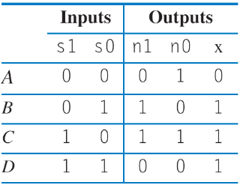
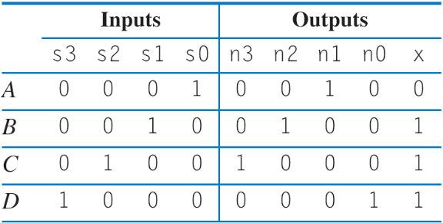
State Encoding: One-Hot Encoding
Inputs: none; Outputs: x
One-hot encoding
  One bit per state – a bit being ‘1’ corresponds to a particular state
  Alternative to minimum bit-width encoding in previous example
  For A, B, C, D: A: 0001, B: 0010, C: 0100, D: 1000
Example: FSM that outputs 0, 1, 1, 1
  Equations if one-hot encoding:
    n3 = s2; n2 = s1; n1 = s0; x = s3 + s2 + s1
  Fewer gates and only one level of logic – less delay than two levels, so faster clock frequency
x=0
x=1
A
00
D
11
0001
1000
B
01
C
10
0010
0100
a
x=1
x=1
x
x
8
n1
6
binary
s3
s2
s1
s0
s1
s0
n0
4
one-hot
clk
2
clk
State register
State register
n0
n1
n2
1
2
3
4
n3
delay (gate-delays)

